Slide 1

Metadata Development Environment
Environment IP
10.9.54.23
Unix user/pwd
bpadmin/bpadminpw
BPI URL
https://10.9.54.23/blueplanet-inventory-rogers-ui
BPI UI user/pwd
normal/12345678
Neo4j URL
http://10.9.54.23:7474/browser
Neo4j user/pwd
neo4j/drni

Slide 2
Metadata Development Environment Setup
Setup Development metadata library
Setup single development library
Use this library for the new Metadata development
Make this library the default library
Add existing libraries as dependencies
Setup Deployment metadata library
Setup single deploy library
Add the development library as a dependency
Use this library for the delta metadata deployment
Use this library for final JSON export

Slide 3
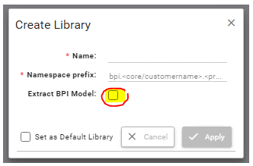
Development Library Setup
Create a new Development Library
Name : <Any meaningful name>
Namespace prefix : bpi.rogers.<Any meaningful name>
Extract BPI Model: not checked
Add Dependent libraries: In order to reuse metadata developed in previous releases, the new development library needs to add the existing library as dependencies.
To model a new IPRAN/Transport domain device, the Sequence of libraries to be added as dependent
Packaging Standard Metadata_Library - bpi.standard.metadata
Library_phase2_devices_1
Phase2_Device_Drawings_latest
Rogers_cardsize_work
Ribbon_Deploy_New_1
Ribbon_Deploy_New_2.1
Phase2_Device_Drawing_Transport_Microwave_Deployment
IPRAN-29-NOV
IPRAN-Roles-Correction

Slide 4
Development Library Setup
10) IPRAN-testing-correction
11) IPRAN-testing-correction-v1
12) IPRAN-Discovery-Changes-v1
13) IPRAN-Discovery-Changes-v2
IPRAN-Discovery-Changes-v3
phase2B_Metadata_Changes_Deploy_V2.json
16) Phase2B_Metadata_Changes_2_Deploy.json
17) Phase2_Metadata_Updates_3_Deploy
18) Phase2_Metadata_Updates_4_Deploy
19) Phase2_Metadata_Updates_5_Deploy
20) Phase2_Metadata_Updates_6_Deploy
To model a new RHP domain device, the Sequence of libraries to be added as dependent
Packaging Standard Metadata_Library - bpi.standard.metadata
Library_phase2_devices_1
Rogers_cardsize_work
Phase2_Device_Drawing_Transport_Microwave_Deployment
Ribbon_Deploy_New_1
Ribbon_Deploy_New_2.1
RHP-NEW-Deploy
RHP-Device-Diagram-Deploy
RHP-Device-Diagram-Deploy-v1
RHP_Metadata-New-V1-Deploy

Slide 5
Development Library Setup
To model a new Ribbon Device in the Transport domain, the Sequence of libraries to be added as dependent
Packaging Standard Metadata_Library - bpi.standard.metadata
Library_phase2_devices_1
Rogers_cardsize_work
Phase2_Device_Drawing_Transport_Microwave_Deployment
Ribbon_Deploy_New_1
Ribbon_Deploy_New_2.1
phase2B_Metadata_Changes_Deploy_V2.json
Phase2B_Metadata_Changes_2_Deploy.json
Phase2_Metadata_Updates_3_Deploy
Phase2_Metadata_Updates_4_Deploy
Phase2_Metadata_Updates_5_Deploy
Phase2_Metadata_Updates_6_Deploy

Slide 6
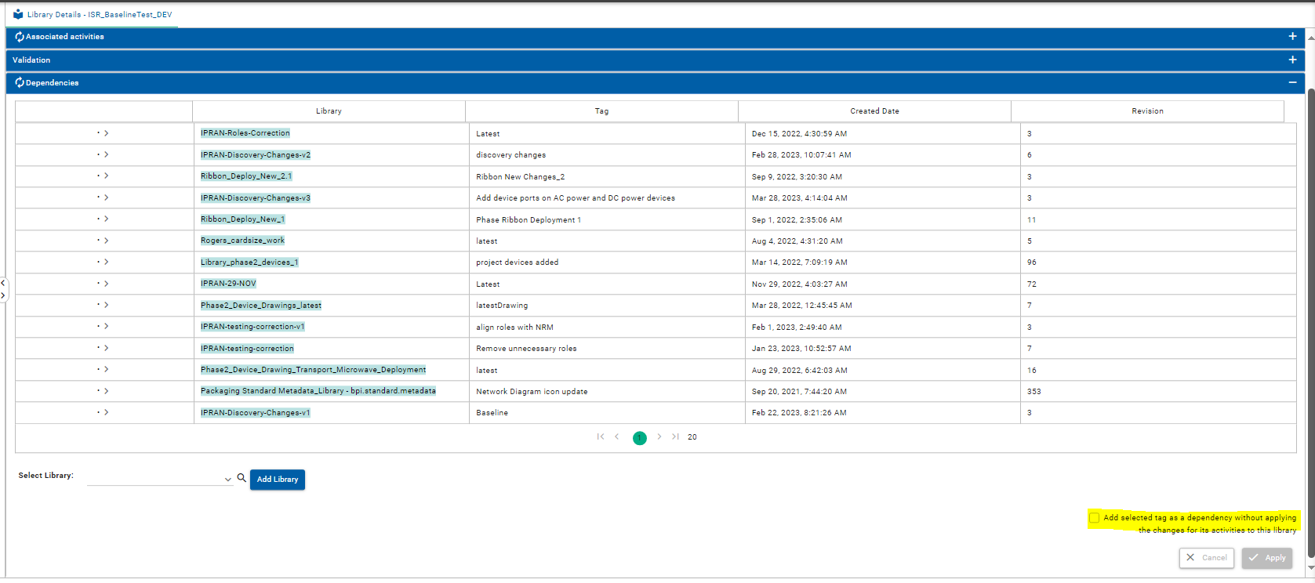
Development Library Setup
For the Development library, do not check this check box

Slide 7
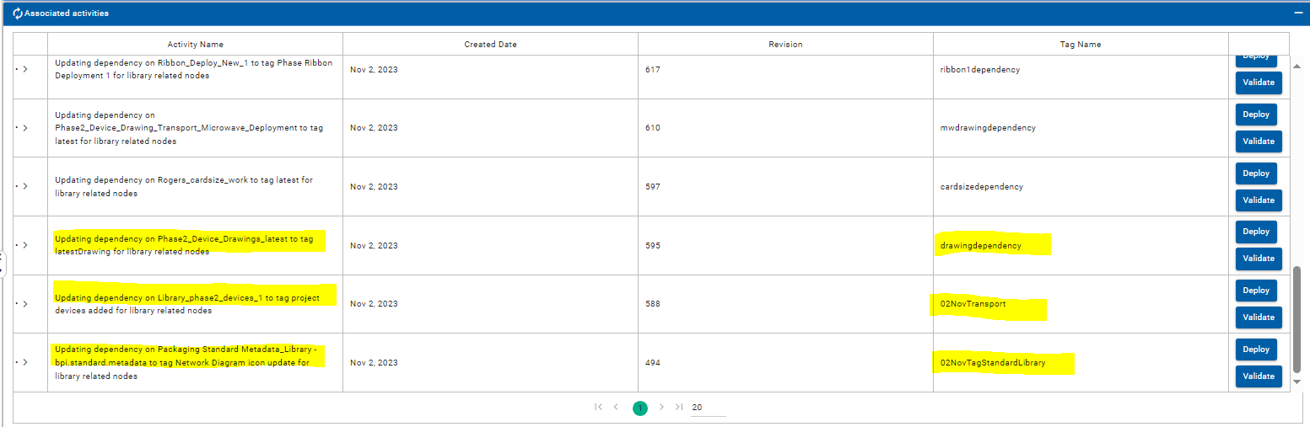
Development Library Setup
Tag the latest activity for each of the dependent libraries. Specify a unique name for the Tag
Do not deploy the Tag from the Development library
Once all dependent libraries are added as dependencies, this library is ready to add new metadata

Slide 8
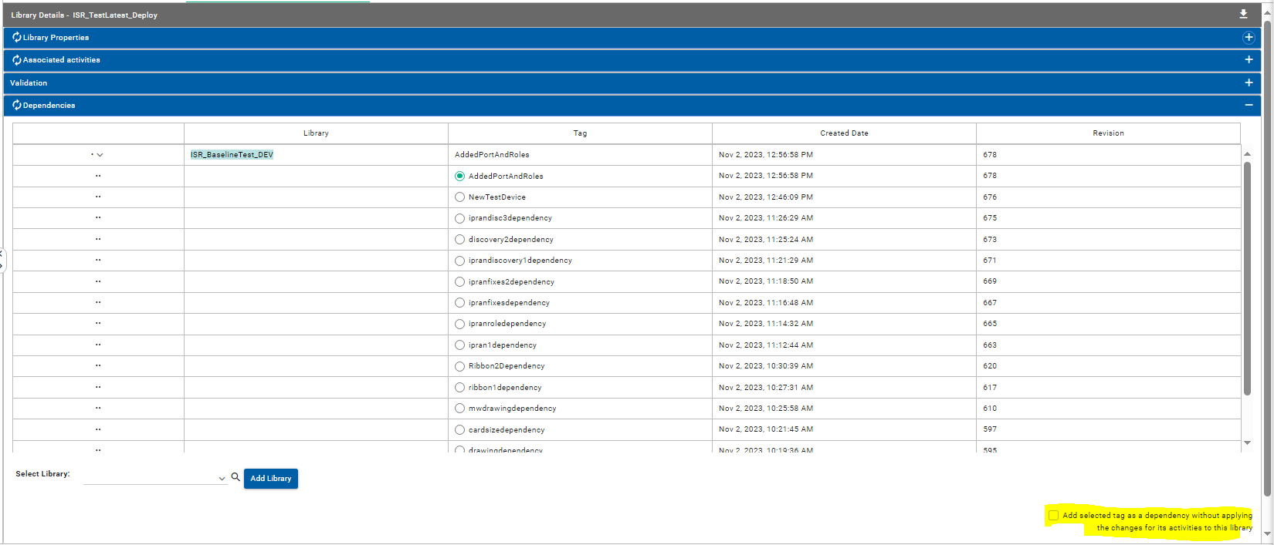
Deployment Library Setup
Create a new library for deployment and name it accordingly
Add the development library already created as the only dependency to this library
Select the latest Tag as shown in the below screenshot
Check the checkbox highlighted in yellow in the below screenshot

Slide 9
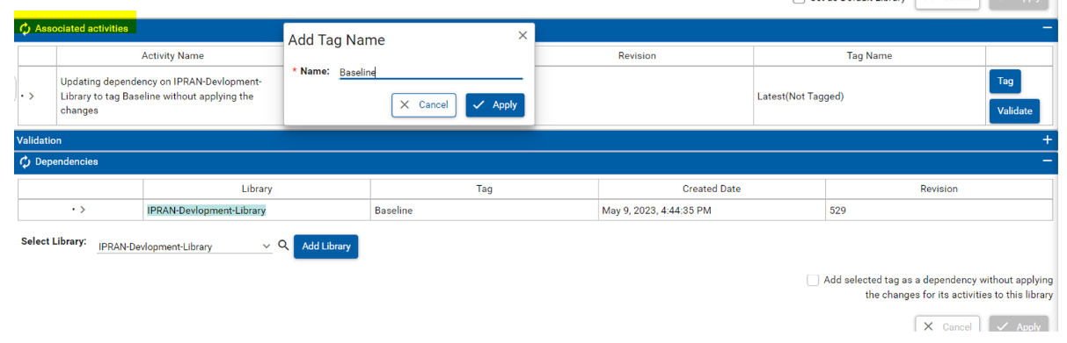

Deployment Library Setup
Tag the latest activity
Deploy the Tag
Now, this library is ready for delta deployment
Once, new activities are Tagged in the Development library, those Tags will be available for the deployment library.
Refresh the
Select the latest Tag
Click Apply without checking the check box

Slide 10
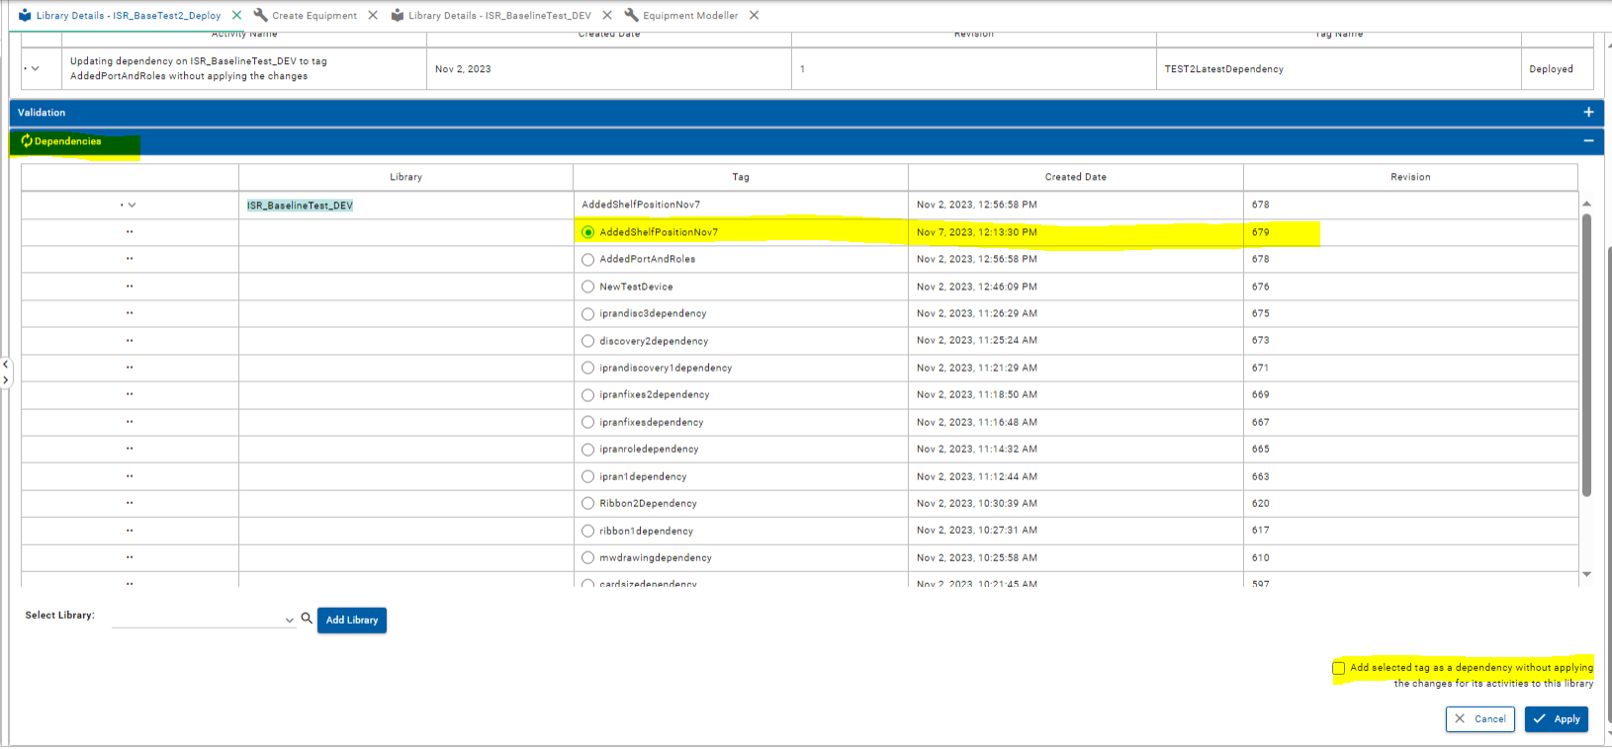

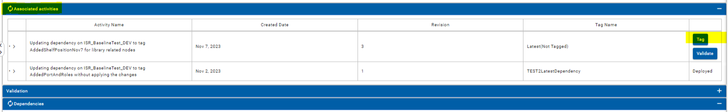
Deployment Library Setup
Once Apply is completed, refresh the
Tag the activity and deploy the tag

Slide 11
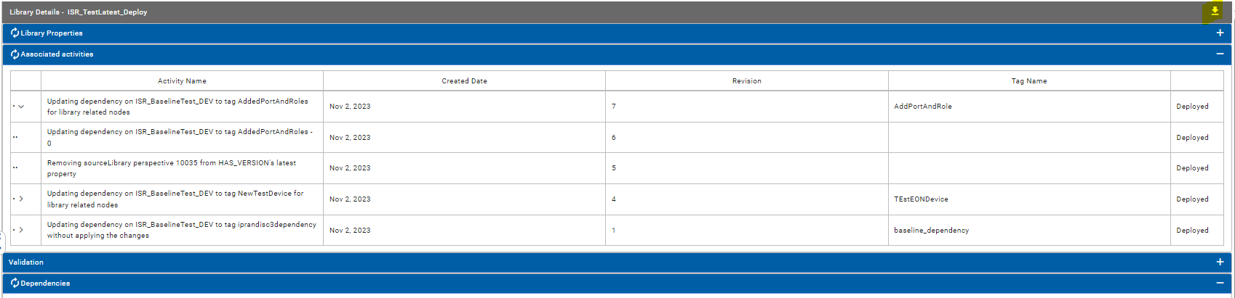
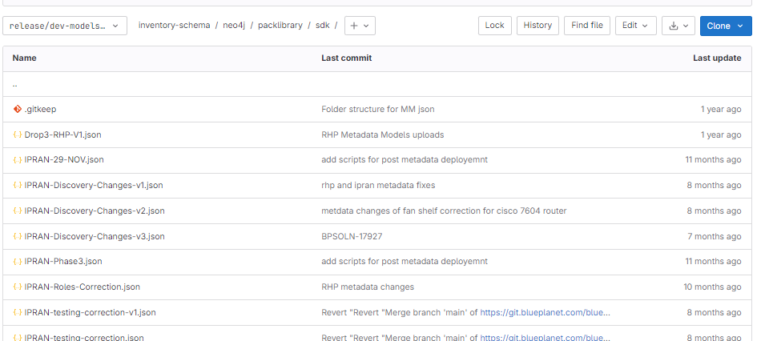
Export Deployment Library
Export the deployment library after testing is completed
Check-in the library to the Gitlab branch
After the deployment library is exported and checked into the Git branch, recreate the new deployment library for subsequent metadata work (follow the same steps again)

Slide 12
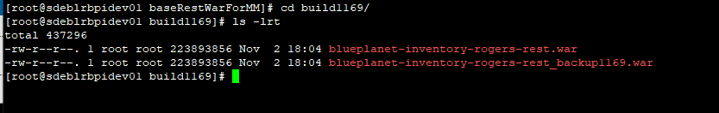
Workaround for Metadata Library setup
To set up a new Development library, old ReST war needs to be deployed, its located under /home/bpadmin/baseRestWarForMM
Copy this war to the custpackage
cp /home/bpadmin/baseRestWarForMM/build1169/blueplanet-inventory-rogers-rest.war /etc/bp2/custartifacts/custpackage/web/webapps/
Restart the custartifacts container. This should restart the web container in ~5 mins.
Once the development library is setup, copy the current ReST war saved under /home/bpadmin/baseRestWarForMM/current to the custpackage and again restart the custartifacts container
cp /home/bpadmin/baseRestWarForMM/current/blueplanet-inventory-rogers-rest.war /etc/bp2/custartifacts/custpackage/web/webapps/

Slide 13
Metadata Delivery Guideline
One or more metadata library JSON to be delivered every drop
Complete device model (including all Cards and SFPs) are expected in the library that is delivered to BP
Naming conventions are also expected for the devices that are delivered in the metadata library
Exported library name will have a sequence in its name to help with the deployment sequence
Check-in exported deploy library JSON to the designated Gitlab branch
Maintain the deploy library sequence in the .txt file

